Slide 1
Introduction to R Shiny

Slide 2
Introduction
Shiny is a framework for developing interactive charts, data visualizations and applications to be hosted on web using the R language.
A shiny App has three components:
User interface object : Layout and appearance of your app
Server function : Instructions that your computer needs to build your app
Call to the shinyApp function : Creates Shiny app objects from an explicit UI/server pair using runApp("directory").
Packages
Shiny
googleVis
Advantages
Open source software, hence, no cost attached
Can be deployed quickly, and will run efficiently
Models can directly run in the backend, hence, no need to set up a process for exporting data into a separate tool.
Notes:
http://www.tableausoftware.com/learn/tutorials/on-demand/r-integration

Slide 3
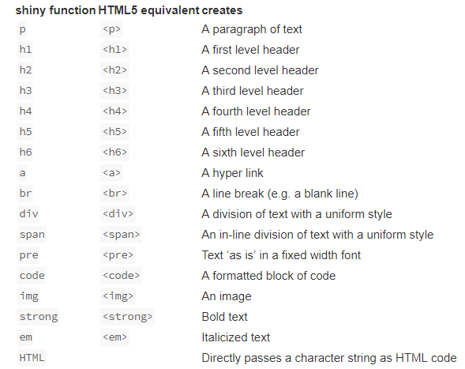
Building a user interface
FLUIDPAGE:
Shiny uses the function fluidPage to create a display that automatically adjusts to the dimensions of your user’s browser window.
TitlePanel : Sets the “official” title of the web page
SidebarLayout : It creates a basic Shiny app with a sidebar. SidebarLayout always takes two arguments:
SidebarPanel function output : We’ll build our app such that all the inputs that the user can manipulate will be in the sidebar
MainPanel function output : the results will be shown in the main panel on the right.

Slide 4
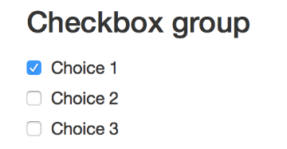
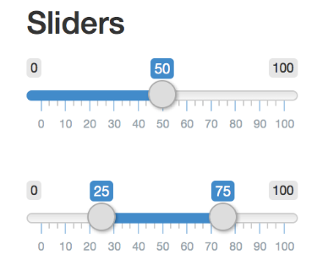
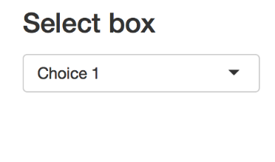
Control Widgets

Slide 5
Display reactive output
SERVER.R:
Builds a list-like object named output that contains all of the code needed to update the R objects in app. Each R object needs to have its own entry in the list.
Steps:
*Output function in the UI to place reactive objects in your Shiny app, Each of the *Output functions require a single argument: a character string that Shiny will use as the name of reactive element.
Render* function in the server to tell Shiny how to build your objects.
Surround R expressions by curly braces, {}, in each render* function.
Saving render* expressions in the output list, with one entry for each reactive object in app.
Creating reactivity by including an input value in a render* expression.
http://10.167.100.185:5050/

